Slide 1
HYGIENE CONTROL IN THE BREWING INDUSTRY
WITH REFERENCE TO AIR SAMPLING
FOR BACTERIA AND PARTICLE CONTROL
Environmental monitoring in
the Food and Beverage Industry
South African Breweries
July 2011
Stephen Marrs
IEPSA

Slide 2
Basic information on Airborne Contamination
Choosing the right monitoring system
Sampling positions and frequency
Biotest solutions

Slide 3
Basic information on Airborne Contamination

Slide 4
Microorganisms: in ambient air
Air is not a natural environment for microorganisms
In the air, Microorganisms are associated with particles
or waterdrops = Bioaerosols (exception : spores)
Bioaeosols carry any kind of microorganism e.g. fungi, bacteria, virus
Bioaerosols are developed by disruption
Particles less than 10µm diameter stay suspended in the air
Airbornes stick to surfaces and stay there if air movement
is below 4 -5 m/sec

Slide 5
Basic Information:
Limitations for the Survival of Microorganisms in the air
Bacterial spores: absolutely resistant to dryness
Fungi: relatively resistant to dryness
Gram (+) Bacteria: relatively resistant to dryness
Gram (-) Bacteria: relatively sensitive to dryness
UV –Light (sun) inactivates airborne micro organisms

Slide 6
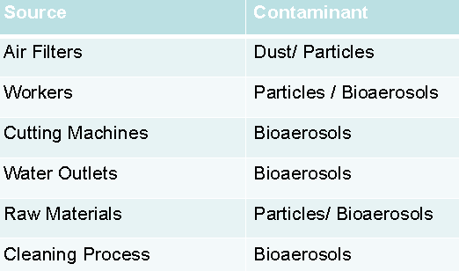
Main Sources of airborne microorganisms
in the Food and beverage Industry

Slide 7
Hygiene Monitoring
Where we do NOT NEED microorganisms
Pharmaceutical production
Processing of food and beverages
Hospital environment
In most cases microbial contamination can not be seen, smelled or tasted
Consequences of non-hygienic production
Loss of quality
Health risk
Blocked production (Lot release) – loss of time and money
Loss of image and market share

Slide 8
Basics of Good Manufacturing Practice GMP
Good Good
Manufacturing Microbiological / Monitoring
Practice Practice
Appropriate production processes and sufficient monitoring should
provide an excellent quality final product
Requirement of:
FDA - Guidelines on Aseptic Processing
USP 24:<116> “microbial evaluation of Clean Rooms and other Controlled
Environments”
ISO 14698-(1-3) describes methods for analysis, measurement and
assessment of bio contamination
DIN/EN 1632-1: critical control points in risk areas

Slide 9
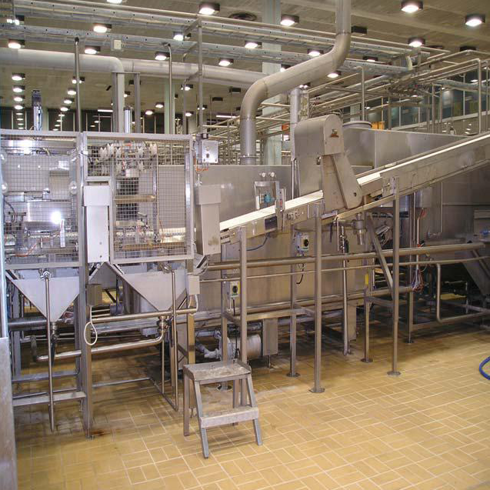

Slide 11
Status of microbial Contamination
Micro organisms can only be detected via conventional
culture methods
requiring several days of incubation time
only trend analysis possible

Slide 12
Choosing the right monitoring system

Slide 14
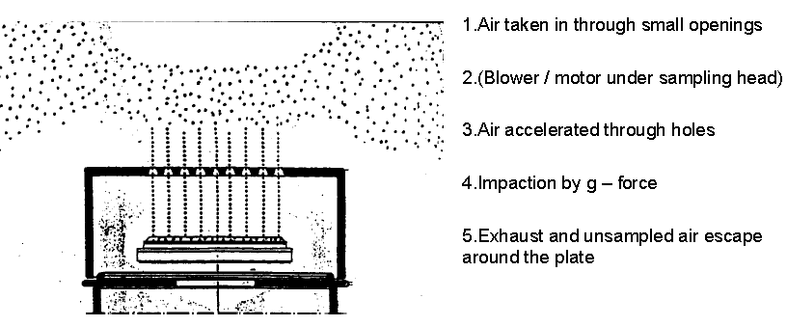
Microbial air sampling
Sieve sampler – Impaction principle

Slide 15
Microbial air sampling
Biotest RCS air sampler – Centrifugal / Impaction principle

Slide 16
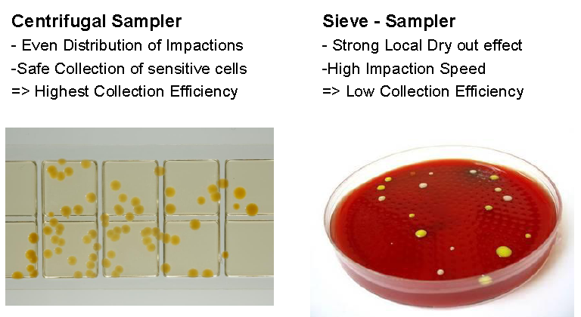
Comparison of air samplers

Slide 17
Regulations
Because of the lack of Regulations for the Food Industry, most companies work according to the Clean Room Standards
As a Result from Analysis like Hazard Analysis and
Critical Control Points (HACCP)
Key Point is a good Monitoring tool based upon Trend Analysis of both Particles and Micro organisms
Notes:
The fundamental objective of air quality monitoring is to collect data that can be used to make informed decisions to best manage and improve the environment.

Slide 18

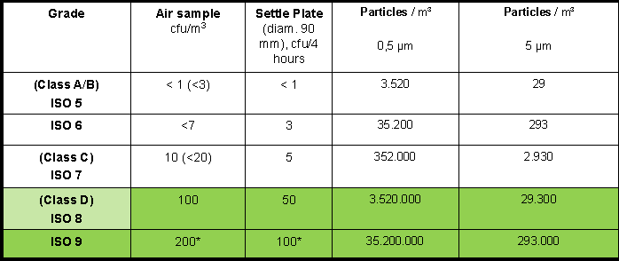
Thresholds (acc. EU, Annex 1, USP, FDA and ISO 14644-1)

Slide 19
Sampling positions and frequency

Slide 20
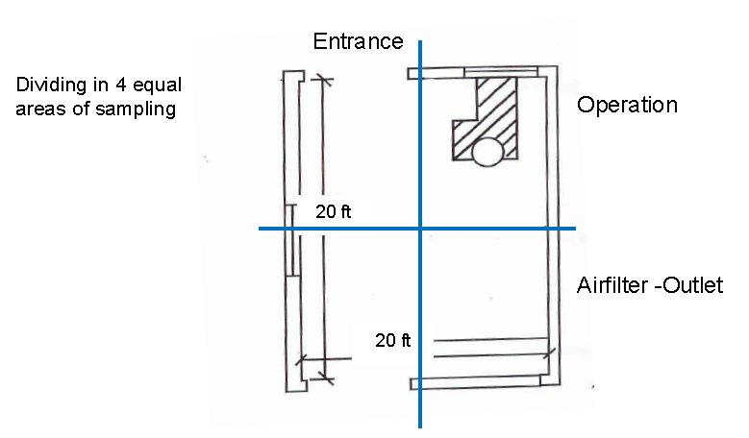
Sampling positions and frequency

Slide 21
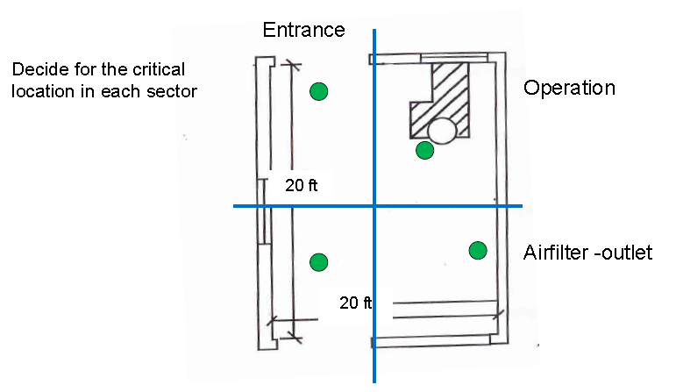
Sampling positions and frequency

Slide 22
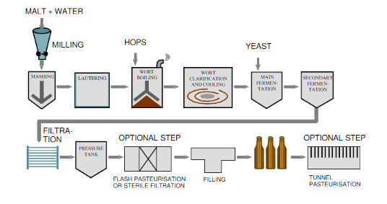

Slide 23
Sampling positions and frequency

Slide 24
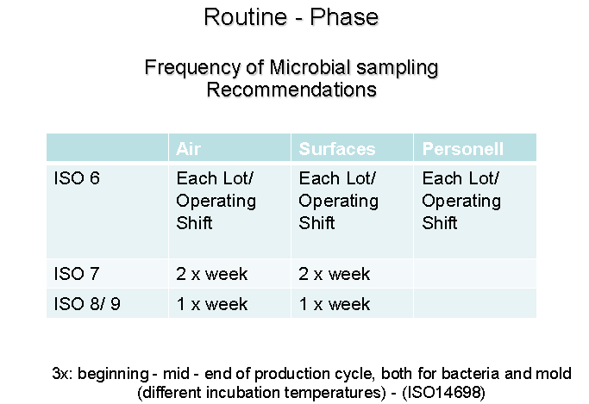
Sampling positions and frequency

Slide 25
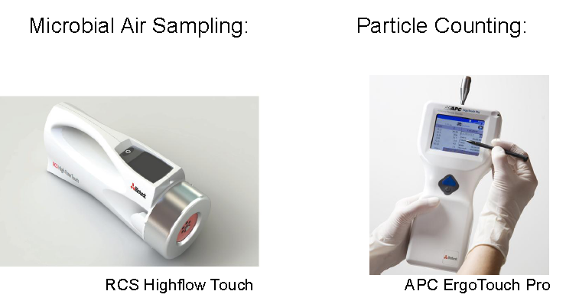
Biotest solutions

Slide 26
Biotest solutions
RCS Highflow Touch
A new generation of Centrifugal Microbial Air samplers
Full colour touchscreen display
System designed for easy & safe operation

Slide 27
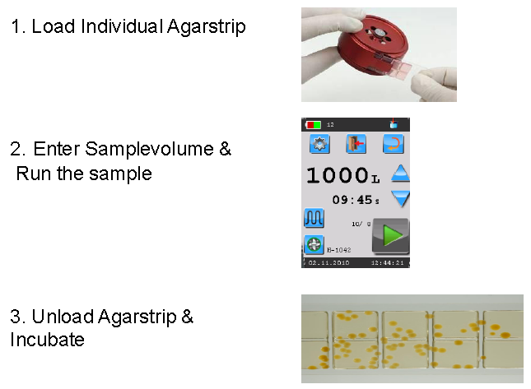
Biotest solutions

Slide 28
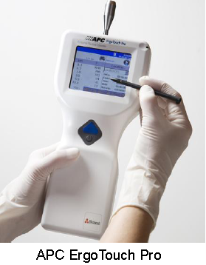
Biotest solutions
Handheld Particle Counter
Easy and safe operation
Individual Channels 0,3µm - 10µm
10.000 records stored in memory
Windows CE & USB connection
Ideally suited for monitoring Processes and filters

Slide 29
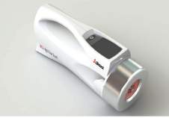
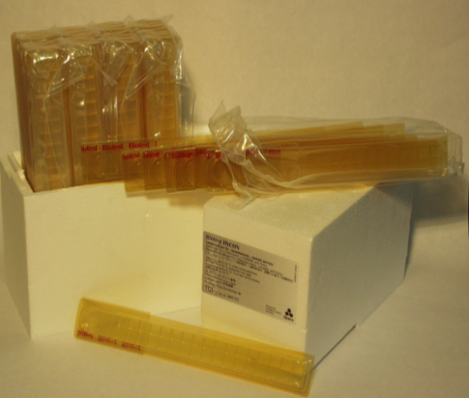
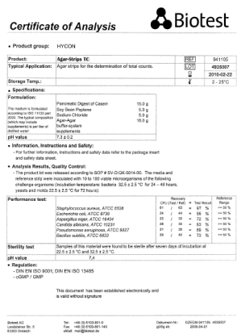
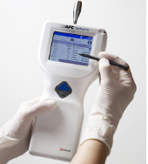
Biotest solutions
Biotest instruments form an efficient team
to monitor the air quality in processing
areas.

Slide 30
Thank you

